Slide 1

SOCIONICS
All slides are copyrighted by Jack Oliver Aaron of the World Socionics Society
A CRASH COURSE

Slide 2
12. HOW TO TYPE
All slides are copyrighted by Jack Oliver Aaron of the World Socionics Society

Slide 3
SO FAR
All slides are copyrighted by Jack Oliver Aaron of the World Socionics Society
IM Elements - The WHAT
Functions - The HOW
Small Groups - Putting it together
The Socion - Each type in detail
Relationships - Seeing them interact

Slide 4
TODAY
All slides are copyrighted by Jack Oliver Aaron of the World Socionics Society
IM Elements - The WHAT
Functions - The HOW
Small Groups - Putting it together
The Socion - Each type in detail
Relationships - Seeing them interact
Typing - Applying what we know

Slide 5
Cheat Sheets
All slides are copyrighted by Jack Oliver Aaron of the World Socionics Society
 | Type
1 | Energiser | Integrator
2 | Sensory | Intuitive
3 | Logical | Ethical
4 | Rational | Irrational
5 | Reductionist | Holist
6 | World-Accepting | World-Rejecting
7 | Clarity-Seeking | Integrity-Seeking
8 | Identifying | Transforming
9 | Determined | Exacting
10 | Contrarian | Obstinate
11 | Space-Locked | Time-Locked
12 | Sight-Locked | Speech-Locked
13 | Affirming | Denying
14 | Thetic | Antithetic
15 | Clockwise | Anticlockwise
 | Information
1 | Perception | Judgement
2 | External | Internal
3 | Detached | Involved
4 | Energising | Integrating
5 | Static | Dynamic
6 | Attractive | Repulsive
7 | Questioning | Conclusive
 | Function
1 | Public | Private
2 | Strong | Weak
3 | Valued | Neglected
4 | Obvious | Subtle
5 | Constant | Variable
6 | Stubborn | Flexible
7 | Demanding | Supplying

Slide 6
Cheat Sheets
All slides are copyrighted by Jack Oliver Aaron of the World Socionics Society
IM Elements | 1 | 2 | 3 | 4 | 5 | 6 | 7
Force | Perception | External | Involved | Energising | Static | Repulsive | Conclusive
Senses | Perception | External | Involved | Integrating | Dynamic | Attractive | Questioning
Ideas | Perception | Internal | Detached | Energising | Static | Attractive | Questioning
Telos | Perception | Internal | Detached | Integrating | Dynamic | Repulsive | Conclusive
Pragmatism | Judgement | External | Detached | Energising | Dynamic | Repulsive | Questioning
Laws | Judgement | External | Detached | Integrating | Static | Attractive | Conclusive
Emotions | Judgement | Internal | Involved | Energising | Dynamic | Attractive | Conclusive
Relations | Judgement | Internal | Involved | Integrating | Static | Repulsive | Questioning

Slide 7
Cheat Sheets
All slides are copyrighted by Jack Oliver Aaron of the World Socionics Society
Model A | 1 | 2 | 3 | 4 | 5 | 6 | 7
Leading | Public | Strong | Valued | Obvious | Constant | Stubborn | Demanding
Creative | Public | Strong | Valued | Subtle | Variable | Flexible | Supplying
Role | Public | Weak | Neglected | Obvious | Variable | Flexible | Demanding
Vulnerable | Public | Weak | Neglected | Subtle | Constant | Stubborn | Supplying
Suggestive | Private | Weak | Valued | Subtle | Constant | Flexible | Demanding
Mobilising | Private | Weak | Valued | Obvious | Variable | Stubborn | Supplying
Ignoring | Private | Strong | Neglected | Subtle | Variable | Stubborn | Demanding
Demonstrative | Private | Strong | Neglected | Obvious | Constant | Flexible | Supplying

Slide 8
Cheat Sheets
All slides are copyrighted by Jack Oliver Aaron of the World Socionics Society
Type | 1 | 2 | 3 | 4 | 5 | 6 | 7 | 8 | 9 | 10 | 11 | 12 | 13 | 14 | 15
ILE | Energiser | Intuitive | Logical | Irrational | Reductionist | Accepting | Clarity | Identifying | Determined | Contrarian | Space | Sight | Affirming | Antithetic | Clockwise
SEI | Integrator | Sensory | Ethical | Irrational | Holist | Accepting | Clarity | Identifying | Exacting | Obstinate | Space | Sight | Denying | Thetic | Clockwise
ESE | Energiser | Sensory | Ethical | Rational | Holist | Accepting | Clarity | Identifying | Determined | Contrarian | Time | Speech | Affirming | Thetic | Anticlockwise
LII | Integrator | Intuitive | Logical | Rational | Reductionist | Accepting | Clarity | Identifying | Exacting | Obstinate | Time | Speech | Denying | Antithetic | Anticlockwise
EIE | Energiser | Intuitive | Ethical | Rational | Holist | Rejecting | Clarity | Transforming | Exacting | Contrarian | Space | Speech | Denying | Antithetic | Clockwise
LSI | Integrator | Sensory | Logical | Rational | Reductionist | Rejecting | Clarity | Transforming | Determined | Obstinate | Space | Speech | Affirming | Thetic | Clockwise
SLE | Energiser | Sensory | Logical | Irrational | Reductionist | Rejecting | Clarity | Transforming | Exacting | Contrarian | Time | Sight | Denying | Thetic | Anticlockwise
IEI | Integrator | Intuitive | Ethical | Irrational | Holist | Rejecting | Clarity | Transforming | Determined | Obstinate | Time | Sight | Affirming | Antithetic | Anticlockwise
SEE | Energiser | Sensory | Ethical | Irrational | Reductionist | Rejecting | Integrity | Identifying | Exacting | Obstinate | Time | Speech | Affirming | Antithetic | Clockwise
ILI | Integrator | Intuitive | Logical | Irrational | Holist | Rejecting | Integrity | Identifying | Determined | Contrarian | Time | Speech | Denying | Thetic | Clockwise
LIE | Energiser | Intuitive | Logical | Rational | Holist | Rejecting | Integrity | Identifying | Exacting | Obstinate | Space | Sight | Affirming | Thetic | Anticlockwise
ESI | Integrator | Sensory | Ethical | Rational | Reductionist | Rejecting | Integrity | Identifying | Determined | Contrarian | Space | Sight | Denying | Antithetic | Anticlockwise
LSE | Energiser | Sensory | Logical | Rational | Holist | Accepting | Integrity | Transforming | Determined | Obstinate | Time | Sight | Denying | Antithetic | Clockwise
EII | Integrator | Intuitive | Ethical | Rational | Reductionist | Accepting | Integrity | Transforming | Exacting | Contrarian | Time | Sight | Affirming | Thetic | Clockwise
IEE | Energiser | Intuitive | Ethical | Irrational | Reductionist | Accepting | Integrity | Transforming | Determined | Obstinate | Space | Speech | Denying | Thetic | Anticlockwise
SLI | Integrator | Sensory | Logical | Irrational | Holist | Accepting | Integrity | Transforming | Exacting | Contrarian | Space | Speech | Affirming | Antithetic | Anticlockwise

Slide 9
ORCE Method
All slides are copyrighted by Jack Oliver Aaron of the World Socionics Society
OBSERVE - First, just pick out the data points
RECORD - Write down notes, keep a list of the data
CLASSIFY - Make Element-to-Function assignments from the data
EVALUATE - Build the Model A for the type, check against other ‘nearby’ types, e.g. Mirror, Activator, Quasi-Identical, Benefactor, Beneficiary, Look-alike and Kindred.

Slide 10
TYPING FORMALLY (best for data-abundant subjects)
All slides are copyrighted by Jack Oliver Aaron of the World Socionics Society
SOURCES: Observe + Record | INTERPRETATION: Classify + Evaluate
Source diversity is strength Not all sources are equal Build the BENCHMARK | Bring sources together Assign Elements to Functions Check your reasoning
Notes:
Taylor Swift: http://worldsocionics.blogspot.com/2017/01/taylor-swift-eii-personality-type.html
Napoleon: http://worldsocionics.blogspot.com/2021/08/napoleon-bonaparte-sle.html
Lucius Cornelius Sulla: http://worldsocionics.blogspot.com/2019/03/lucius-cornelius-sulla-esi-personality.html
Barack Obama: http://worldsocionics.blogspot.com/2017/01/barack-obama-iei-personality-type.html

Slide 11
O+R: SOURCE DIVERSITY IS STRENGTH
All slides are copyrighted by Jack Oliver Aaron of the World Socionics Society
The more sources the merrier…
Direct conversations
Video interviews, multiple at different stages in life
Letters and quotations
Accounts by people who know the subject
Biographies, etc.
With historical sources, SOME SOURCES UNAVAILABLE
Instead of video, look at letters and biographies
Make good use of 2nd person accounts
Be mindful of contemporary agendas, balance out with work of historians

Slide 12
Quotes give a snapshot
All slides are copyrighted by Jack Oliver Aaron of the World Socionics Society
“If you want something said, ask a man; if you want something done, ask a woman.”
“If you set out to be liked, you would be prepared to compromise on anything at any time and you would achieve nothing.”
“Plan your work for today and every day, then work your plan.”
“I am extraordinarily patient, provided I get my own way in the end.”
“I am extraordinarily patient, provided I get my own way in the end.”
“There is no such thing as society; there are individual men and women, and there are families.”
“I usually make up my mind about a man in ten seconds, and I rarely change it.”
DIRECT FROM SOURCE
BUT UNRELIABLE OUT OF CONTEXT

Slide 13
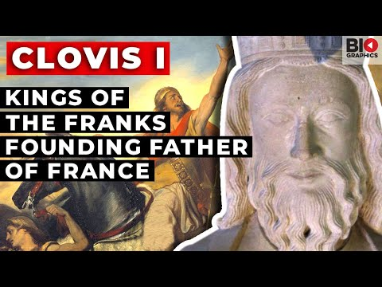
Biographies give the big picture
All slides are copyrighted by Jack Oliver Aaron of the World Socionics Society
OFTEN INDIRECTLY INTERPRETED
LONGITUDINAL, CONTEXT GIVEN

Slide 14
O+R: NOT ALL SOURCES ARE EQUAL
All slides are copyrighted by Jack Oliver Aaron of the World Socionics Society
Think about how representative the data is
Videos and quotes give you a lot, but just a snapshot
Text, especially biographies, can be longitudinal
Think about potential bias in the data
1st person account, full of rich details, but will be biased
2nd person account, a good balance, but look out for an agenda
3rd person account, lacks insider details but most impartial
Think about the context
Some questions asked are leading or carry social pressure
Some situations demand the same response from anyone

Slide 15
Special Considerations
All slides are copyrighted by Jack Oliver Aaron of the World Socionics Society
Deception is inherent in some professions:
Politicians
Actors
Some sources may look 1st person, but actually may not be…
Speeches written by a speech-writer, not the politician
Ghostwritten autobiographies
Songs written by other people, but sung by the artist
Some types are good at appearing as other types, e.g. EIE
Some types are unreliable self-narrators, e.g. IEE & SEE

Slide 16
O+R: BUILD THE BENCHMARK
All slides are copyrighted by Jack Oliver Aaron of the World Socionics Society
Consider ‘the benchmark’: what a normal, reasonable person would do
This can change in each situation, so MUST be grounded in context
Roughly 80-90% of behaviour conforms to benchmark, regardless of type
THEN ask how does the subject deviate from the benchmark and why?
Each deviation is a data point

Slide 17
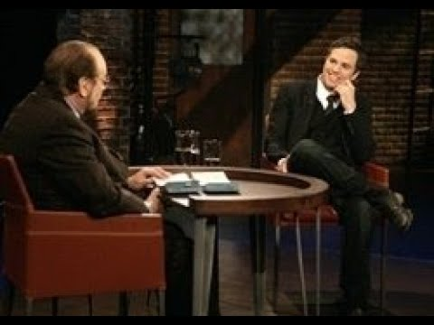
Exercise: Practise Observations
All slides are copyrighted by Jack Oliver Aaron of the World Socionics Society
Watch the video in your own time
Note down key observations.
Think about the benchmark
How did he vary from the benchmark?
Why might he have varied?
Is it enough to type him?

Slide 18
C+E: BRING SOURCES TOGETHER
All slides are copyrighted by Jack Oliver Aaron of the World Socionics Society
Collect multiple data points or snapshots
Identify recurring patterns between data points
Draw out the broader themes to create a broad brush picture
Some sources have already done the work for you, e.g. articles but beware an agenda
Analyse/interpret these themes

Slide 19
When sources clash…
All slides are copyrighted by Jack Oliver Aaron of the World Socionics Society
Ask yourself… do they really clash? Could it be the same type in different situations? HAS THE BENCHMARK CHANGED?
Remember Constant/Variable, some functions switch on and off.
Others don’t:
Leading always in charge.
Vulnerable always blind spot.
If they definitely clash, consider why, who might be mistaken?
Could be due to personal bias or agenda
Could be due to missing data in analysis

Slide 20
C+E: ASSIGN ELEMENTS TO FUNCTIONS
All slides are copyrighted by Jack Oliver Aaron of the World Socionics Society
When interpreting data, pick out the IM Elements being engaged with
Use the 7x Information Dichotomies to check it is correct
When analysing the broad brush picture, consider which IM Element fits which Function of Model A for the subject
Use the 7x Function Dichotomies to check your interpretation
A complete typing: all 8x Elements assigned to 8x Functions
GOLD STANDARD

Slide 21
C+E: CHECK YOUR REASONING
All slides are copyrighted by Jack Oliver Aaron of the World Socionics Society
MIRROR?
Look for the deficit
Could Suggestive and Mobilising be swapped?
How about Demonstrative and Ignoring?
ACTIVATOR?
Again, look for the deficit
Could Suggestive and Creative be swapped?
QUASI-IDENTICAL?
Focus in on Super-Id - What excites them, and what upsets them? What do they need? What do they not care for?

Slide 22
C+E: CHECK YOUR REASONING
All slides are copyrighted by Jack Oliver Aaron of the World Socionics Society
LOOK-A-LIKE?
Run through each Demanding function
Could Leading & Role be swapped? Suggestive & Ignoring?
KINDRED?
Run through each Supplying function
Could Creative & Vulnerable be swapped? Mobilising & Demonstrative?
BENEFIT?
Look at the other types in the ring
Should see similarities with BOTH Benefactor AND Beneficiary
Should differ markedly from Silhouette

Slide 23
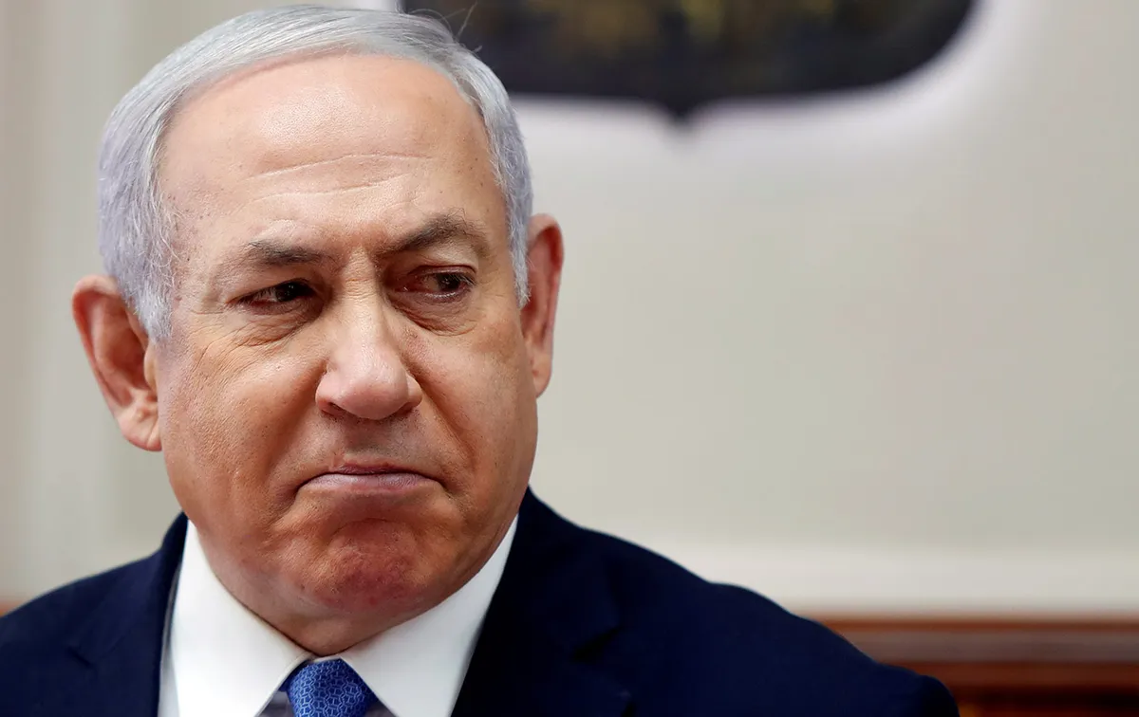
Exercise: Practise Formal Typing
All slides are copyrighted by Jack Oliver Aaron of the World Socionics Society
Type someone you probably don’t know:
The returning PM of Israel: Benjamin Netanyahu
Think carefully about diversity and quality of sources

Slide 24
TYPING INFORMALLY (better for people in real life)
All slides are copyrighted by Jack Oliver Aaron of the World Socionics Society
SOURCES: Observe + Record | INTERPRETATION: Classify + Evaluate
Ask good questions Observe in different situations Seek different perspectives | Assign small groups Use heuristics with care Form your hypothesis Check your hypothesis
Notes:
WSS Diagnostic Interviews: https://www.youtube.com/playlist?list=PLyHHQJsVcBWclExDJ4ydo2-MEWHh7FiJ4

Slide 25
O+R: ASK GOOD QUESTIONS
All slides are copyrighted by Jack Oliver Aaron of the World Socionics Society
Better not to ask questions, unless it’s an agreed and scheduled interview. It can put people on the spot otherwise.
If asking questions, keep them open-ended
Let the subject choose how they like to answer the question
Avoid leading questions, e.g. you like x, don’t you?
Avoid questions likely to lead to social desirability bias
Be mindful of self-delusion
If what they say does not match what they show to you, be sceptical
Pay attention and question where answers seem to contradict

Slide 26
O+R: OBSERVE IN DIFFERENT SITUATIONS
All slides are copyrighted by Jack Oliver Aaron of the World Socionics Society
Best information is when the subject is relaxed, not having to think
Nevertheless, different situations cause people to behave differently
Keep in mind, in MOST situations, most people conform to benchmark
Try to gather observations across familial, social and professional contexts, as well as personal lifestyle and hobbies
Get a benchmark of ‘normal’ behaviour for each context.
Where do they deviate?
What do they do that is abnormal?
What does that say about their strengths and motivations?

Slide 27
O+R: SEEK DIFFERENT PERSPECTIVES
All slides are copyrighted by Jack Oliver Aaron of the World Socionics Society
You are one, biased person
If you get an idea on someone’s type, that biases future observations
Confirmation bias can stop you seeing other potential typings
Challenge your assumptions about the types, especially your own
Discussing your findings with other people helps to find new options
360-degree approach leads to better data.
The subject thinks x of themselves
What do their friends think?
What do their colleagues think?
What does their spouse think?

Slide 28
C+E: ASSIGN SMALL GROUPS
All slides are copyrighted by Jack Oliver Aaron of the World Socionics Society
First assign Quadra
Then assign Clubs,Tournaments to find Type within Quadra
Temperaments and Axes can assist with (2) if needed.
Stand-offs and Courses more fun to think about than good for typing
Other considerations:
Communication and Movement style useful for initial heuristics
If Small Groups not clear-cut, get the general ballpark of similar types:
Go to “Check Your Reasoning” to then narrow down (Slides 21+22)

Slide 29
C+E: USE HEURISTICS WITH CARE
All slides are copyrighted by Jack Oliver Aaron of the World Socionics Society
Just starting out, you have likely not very good heuristics
Takes years to develop good heuristics
Some people get stuck on bad heuristics, prevents them from growing
Use heuristics as a starting point, but later challenge assumptions
Plan to change your mind, or you won’t get better
Communication and Movement Styles good for directing and training heuristics.

Slide 30
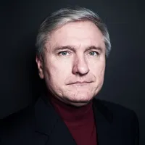
Communication Styles
All slides are copyrighted by Jack Oliver Aaron of the World Socionics Society
Grouped by:
Judgements that are 4D (Strong & Bold)
Share the following:
Observable style of communicating information

Slide 31
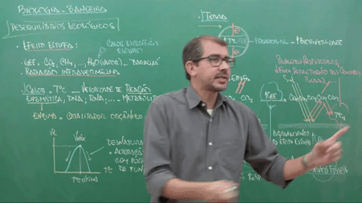
Business-like
All slides are copyrighted by Jack Oliver Aaron of the World Socionics Society
4D Pragmatism
Factual, articulate and informative communication
Can be too much information
Can come across as impersonal
ILE, SLE, LIE & LSE
Notes:
Bill Gates (LIE): https://www.youtube.com/watch?v=obRG-2jurz0

Slide 32
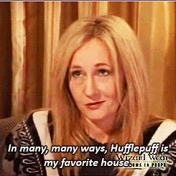
Sincere
All slides are copyrighted by Jack Oliver Aaron of the World Socionics Society
4D Relations
Relatable, heartfelt and intimate communication
Can be too personal
Can lack factual content or adequate articulation
SEI, IEI, ESI & EII
Notes:
Gene Wilder (EII): https://www.youtube.com/watch?v=5B3v7OKNvp4

Slide 33

Passionate
All slides are copyrighted by Jack Oliver Aaron of the World Socionics Society
4D Emotions
Vibrant, emotive and warm communication
Can be too dramatic
Can lack coherence like a flow of consciousness
ESE, EIE, SEE & IEE
Notes:
Oprah Winfrey (EIE): https://www.youtube.com/watch?v=TgWt9JC-y9U

Slide 34
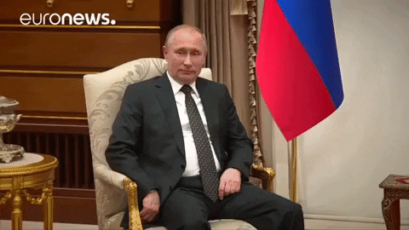
Concise
All slides are copyrighted by Jack Oliver Aaron of the World Socionics Society
4D Laws
Clear, precise and parsimonious communication
Can be too technical to the point of being obscure/arcane
Can be ineffectual, cold or even unfriendly
LII, LSI, ILI & SLI
Notes:
Kimi Raikkonen (SLI): https://www.youtube.com/watch?v=xZlNB8ucT9o

Slide 35
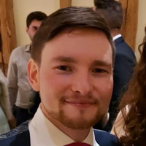
Movement Styles
All slides are copyrighted by Jack Oliver Aaron of the World Socionics Society
Grouped by:
Perceptions that are 4D (Strong & Bold)
Share the following:
Observable style of navigating surroundings

Slide 36
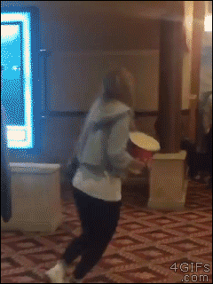
Clumsy
All slides are copyrighted by Jack Oliver Aaron of the World Socionics Society
4D Ideas
Quick, jerky and superfluous movements
Can overfidget, sit oddly or even forget to breath
Can lack grace and control
ILE, EIE, LIE & IEE
Notes:
Al Waleed bin Talal (LIE): https://www.youtube.com/watch?v=mKCOH3R6JK8
Slavoj Zizek (ILE): https://www.youtube.com/watch?v=XS_Lzo4S8lA

Slide 37
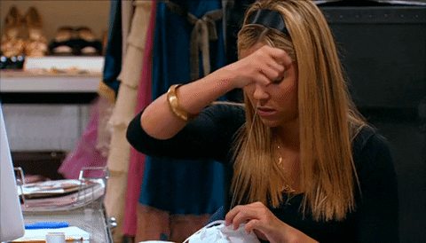
Stable
All slides are copyrighted by Jack Oliver Aaron of the World Socionics Society
4D Senses
Relaxed, deliberate and precise movements
Can seem very grounded and at home in their space
Can be almost lethargic
SEI, LSI, ESI & SLI
Notes:
Vladimir Putin LSI: https://www.youtube.com/watch?v=ucEs0nBuowE
Gwyneth Paltrow SEI: https://www.youtube.com/watch?v=0MO8GEtJwHo

Slide 38
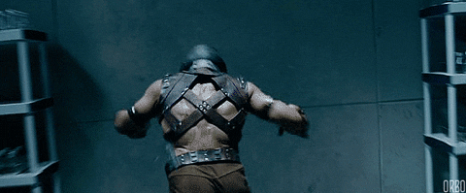
Powerful
All slides are copyrighted by Jack Oliver Aaron of the World Socionics Society
4D Force
Decisive, energetic and impactful movements
Can dominate or overwhelm others in the space
Can take impulsive risks in the space
ESE, SLE, SEE & LSE
Notes:
Muhammad Ali (SLE): https://www.youtube.com/watch?v=jkhpZoPOfZI
Donald Trump (SLE): https://www.youtube.com/watch?v=f_LNr0Opqss
Robin Williams (ESE): https://www.youtube.com/watch?v=nIWB-Neyj-c

Slide 39

Fragile
All slides are copyrighted by Jack Oliver Aaron of the World Socionics Society
4D Telos
Slow, doddery and cautious movements
Can be too mentally absorbed and be unresponsive
Can lack presence and react poorly to sudden changes
LII, IEI, ILI & EII
Notes:
Bernie Sanders (LII): https://www.youtube.com/watch?v=M0wGd6CHdxI
JK Rowling (EII): https://www.youtube.com/watch?v=Bkkw3JRhayw
Barack Obama (IEI): https://www.youtube.com/watch?v=gZR1CvSQntE

Slide 40
C+E: YOUR HYPOTHESIS
All slides are copyrighted by Jack Oliver Aaron of the World Socionics Society
Remember you used an informal method to reach your typing
Not a conclusion, only a hypothesis
Be humble, check your hypothesis with your subject
Do they agree? If so, you are probably right.
Do they disagree? Don’t argue, listen first, see if you should reconsider
You WILL get things wrong
A good socionist recognises and learns from getting it wrong.

Slide 41
Ethical use of Socionics…
All slides are copyrighted by Jack Oliver Aaron of the World Socionics Society
Socionics is a pre-science, not a true science yet
Good for post hoc analysis, not so good for predictions
Keep that in mind
Be careful when telling people if their relationships will work or not
Be careful when making decisions about someone’s competence
Be ready and willing to learn more nuances from experience

Slide 42
Exercise: Practise Informal Typing
All slides are copyrighted by Jack Oliver Aaron of the World Socionics Society
Type someone you know
Think about how you went about it
Then answer these questions to yourself:
What was easiest for you to notice about them?
What parts were unclear?
Finally, test your typing hypothesis…
Read a profile to them
See if it’s accurate
Counter-test by reading Conflictor profile to them.

Slide 43
THE ASSIGNMENT
All slides are copyrighted by Jack Oliver Aaron of the World Socionics Society
Write a type diagnostic essay on a public figure and email to me
Must not be too obscure as you need sufficient data to type them formally
Must not be on the WSS Benchmark, as that can pre-set your opinion
Must be a different subject from your peers
Format should introduce the person, then provide a robust argument for each IM Element in each Function of Model A
Argument should show clear understanding of theory, and how to both gather and interpret data in an insightful but responsible way
Passing of assignment is optional, but required to receive the accreditation
No time limit and can make multiple attempts
Submissions will be marked with feedback if no pass on first attempt
Successful submissions will, with your permission, be featured on WSS blog

Slide 44
THE END
All slides are copyrighted by Jack Oliver Aaron of the World Socionics Society
Facebook Page: www.facebook.com/worldsocionicssociety
Facebook Group: www.facebook.com/groups/worldsocionicssociety
YouTube Channel: https://www.youtube.com/channel/UCDZsJ4kXHJqX9n_0cKuf9JQ
Blog: https://worldsocionics.blogspot.com/
Email: worldsocionics@hotmail.com

